Slide 1
Building Smart Apps with Azure Machine Learning
Jeff Prosise
jeffpro@wintellect.com

Slide 2

Machine Learning
Branch of computer science in which a computer "learns" from data
Credit-card fraud detection
Recommendations
Self-driving cars
Supervised learning
Unsupervised learning
Notes:
Machine Learning finds patterns in large volumes of data and uses those patterns to perform predictive analysis. Microsoft offers Azure Machine Learning, while Amazon offers Amazon Machine Learning and Google offers the Google Prediction API. Software products such as MATLAB support traditional, non-cloud-based ML modeling.
Machine learning models fall into two broad categories: supervised and unsupervised. In supervised learning, the model is "trained" with a large volume of data and algorithms are then used to predict an outcome from future inputs. Most supervised learning models use regression algorithms to compute an outcome from a continuous set of possible outcomes (for example, your score on a test), or classification algorithms to compute the probability of an outcome from a finite set of possible outcomes (for example, the probability that an e-mail is spam or a credit-card transaction is fraudulent). In unsupervised learning, the computer isn't trained, but is presented with a set of data and challenged to find relationships in it. K-Means Clustering is a common unsupervised learning algorithm. For a great explanation of how it works, see https://blog.intercom.io/machine-learning-way-easier-than-it-looks/.

Slide 3
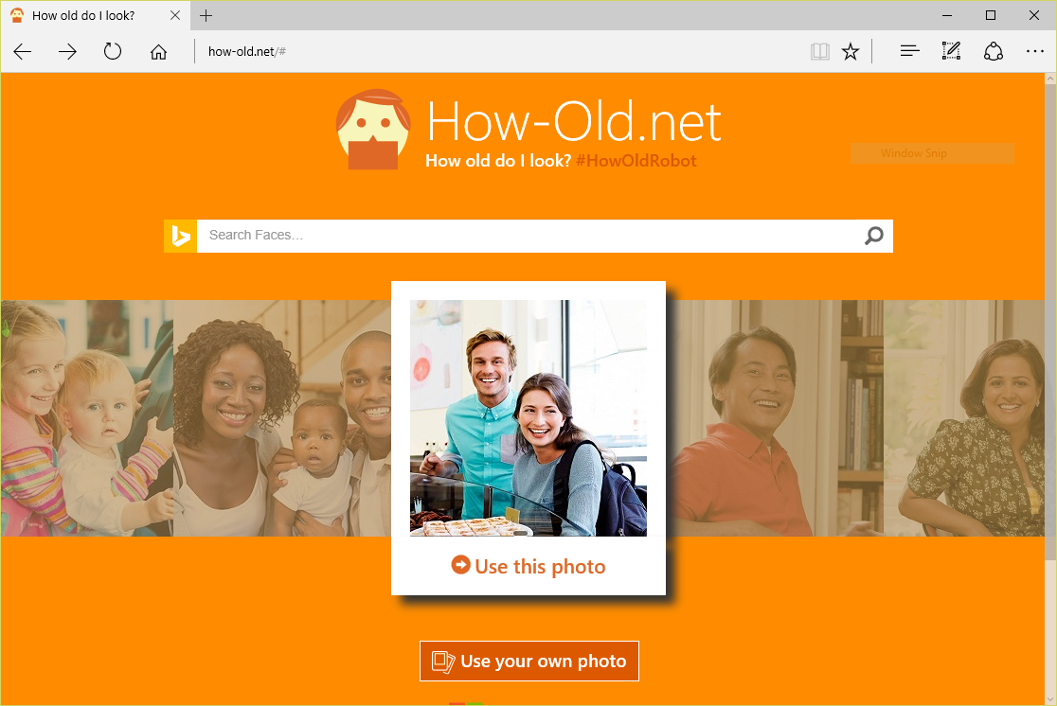
Machine Learning in Action
Notes:
https://how-old.net/# offers a great example of machine learning in action. Created by Microsoft, the site uses advanced image-recognition techniques to analyze photos you upload and then uses an ML model to "predict" the ages of the people in the photos.

Slide 4
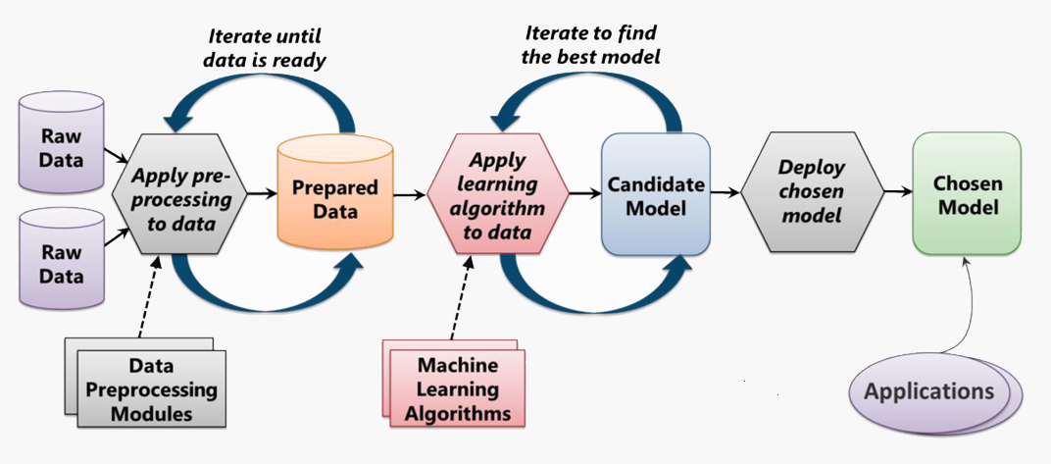
The Machine Learning Process
From: Introduction to Microsoft Azure by David Chappell

Slide 5
Azure Machine Learning
Fully managed cloud service for building and operationalizing machine-learning models
Fully managed
Integrated
Best-in-Class Algorithms + R
Deploy in minutes
No software to install, no hardware to manage, and one portal to view and update.
Simple drag, drop, and connect interface for Data Science. No need for programming for common tasks.
Built-in collection of best of breed algorithms. Support for R and popular CRAN packages.
Operationalize models with a single click. Monetize in Machine Learning Marketplace.
Notes:
Azure Machine Learning is a cloud-based predictive-analytics service that offers a streamlined experience for data scientists of all skill levels. It's accompanied by the Azure Machine Learning Studio (ML Studio), which is a browser-based tool that provides an easy to use, drag-and-drop interface for building machine-learning models. It comes with a library of time-saving experiments and features best-in-class algorithms developed and tested in the real world by Microsoft businesses such as Bing. And its built-in support for R and Python means you can build custom scripts to customize your model. Once you've built and trained your model in the ML Studio, you can easily expose it as a Web service that is consumable from a variety of programming languages, or share it with the community by placing it in the Cortana Intelligence Gallery.

Slide 6


I spent last semester building a regression model in Python, and I just did the same thing in 10 minutes with Azure ML
Notes:
This quote came from a graduate student who attended this class at UMass. He had already accepted at offer to go to work for Microsoft post-graduation. ☺

Slide 7
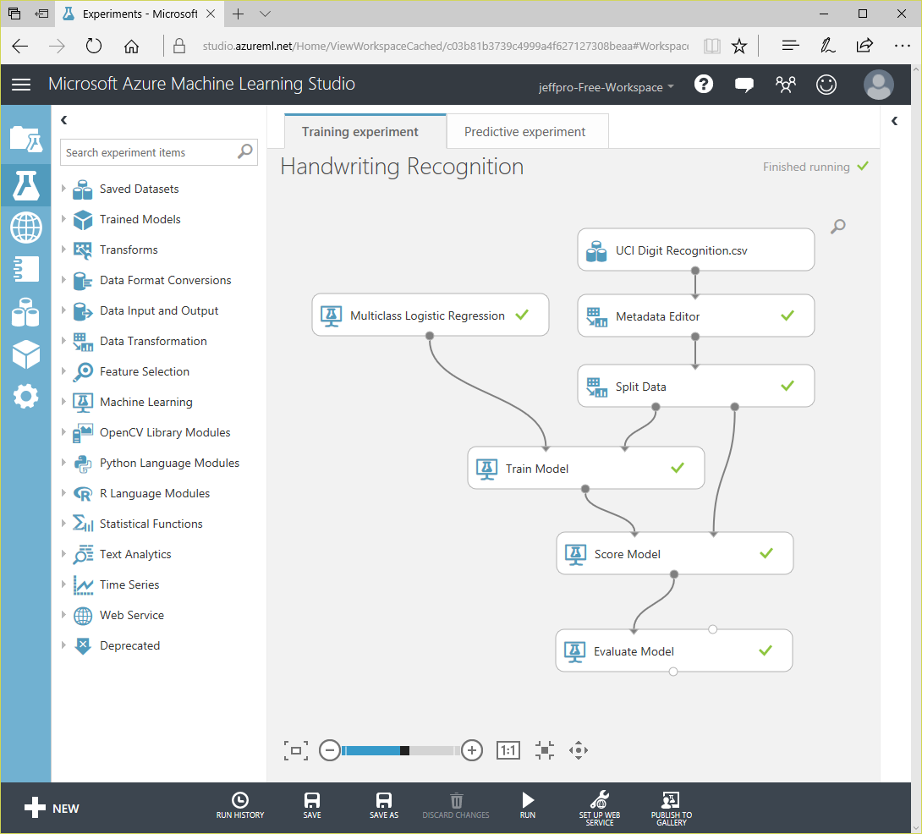
Azure Machine Learning Studio
Visual editor for composing, testing, and deploying ML models
Hundreds of modules for crafting workflows
25 algorithms for classification, regression, and more
Supports text input, CSV, TSV, OData, RData, Excel, zip files, and more
Supports R and Python
Notes:
ML Studio simplifies machine learning by providing a drag-and-drop model in which you build workflow. With ML Studio and the rich of assortment of modules it offers for modeling workflow, you can often build sophisticated models without writing a single line of code. However, it allows you to insert R and Python code anywhere in the workflow, providing infinite flexibility in what you can model.

Slide 8
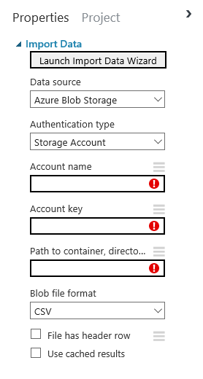
Getting Data In and Out
Upload data from local file
Or use Import Data module to import from Azure blob, Azure table, Azure DocumentDB, Azure SQL, on-prem database, URL, Hive query, and other sources
Export to Hive, SQL, table, or blob with Export Data module
Notes:
Azure ML also includes an Import Images module, which imports a collection of images from blob storage and creates an OpenCV dataset from them.

Slide 9
Cleaning and Transforming Data
30 modules for common data-preparation tasks
Select Columns
in Dataset
Specify which columns to include or exclude
Edit Metadata
Edit column metadata (e.g., identify categorical values)
Remove
Duplicate Rows
Remove duplicate rows to avoid training bias
Apply SQL
Transformation
Transform data using SQL query
Balance imbalanced training data using Synthetic Minority Oversampling Technique
SMOTE

Slide 10
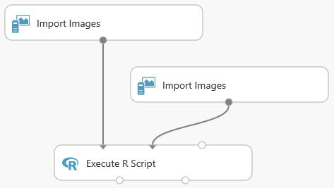
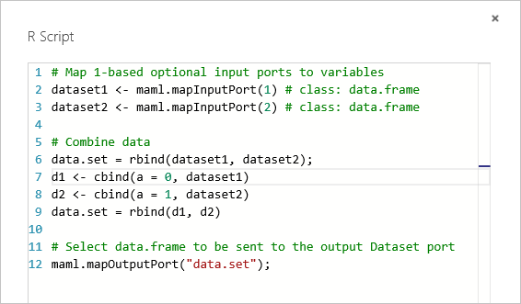
Using R to Transform Data
Use Execute R Script module to implement custom transforms in R (or Execute Python Script for Python)
Notes:
ML Studio has approximately 400 popular R packages built in. The third input port to the Execute R Script module accepts a zip file containing R packages, which makes it easy to import additional packages. Not all R packages are supported. For more information, see https://msdn.microsoft.com/en-us/library/azure/mt741980.aspx.

Slide 11
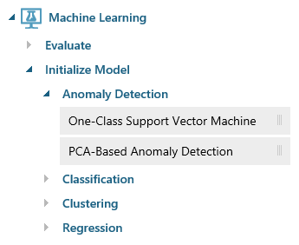
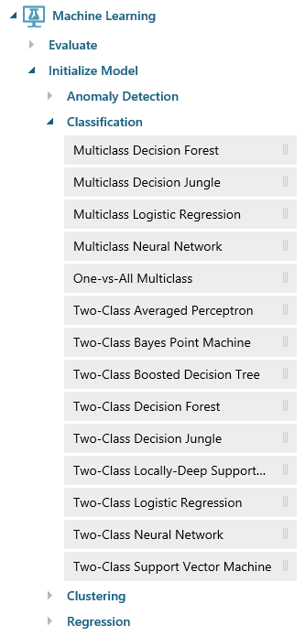
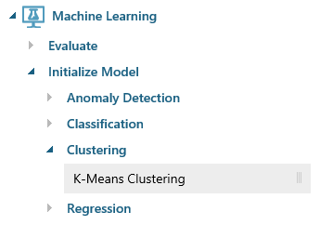
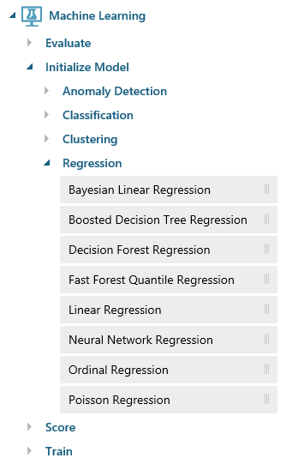
Built-in Algorithms
Notes:
Anomaly detection is the identification of items, events, or observations which do not conform to an expected pattern or other items in a dataset. A classic example is examining a dataset representing banking transactions and detecting potentially fraudulent transactions in that group.
Regression algorithms seek to establish and quantify relationships between variables. By establishing a relationship between a dependent variable and one or more independent variables, regression analysis can enable the value of a dependent variable to be predicted given a set of inputs with a quantifiable accuracy. A great example can be seen at https://how-old.net/#, a site that lets you upload a photo and then guesses your age with uncanny accuracy. The site uses Azure Machine Learning and combines classic regression with advanced image recognition.
The purpose of classification algorithms is to identify the category to which an observation belongs based on training data consisting of observations which have already been classified (assigned to a category). A great example is determining whether an e-mail belongs to the "spam" category or the "not-spam" category.
Clustering seeks to group a set of objects in such a way that objects in the same group (called a cluster) are more similar to each other than to those in other groups (clusters).

Slide 12
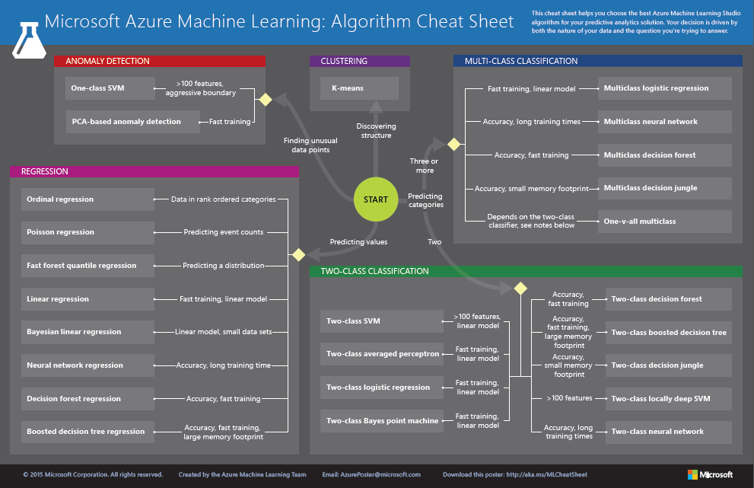
http://aka.ms/MLCheatSheet
Notes:
One example here is if you want to use a set of input values to predict an output value, use linear regression. But if you're more interested in the distribution of the output use fast forest quantile regression instead. An example of when you would use the latter is using growth charts to assess child development. "Abby's height is in the 10% quantile of the heights of kids her age."

Slide 13
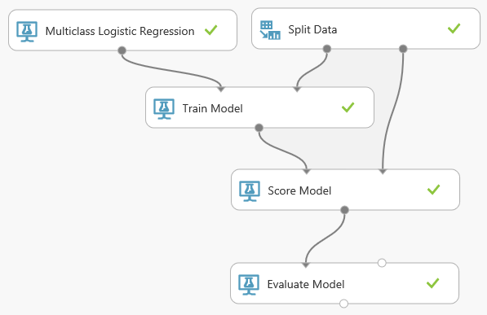
Training, Scoring, and Evaluating Models
Train Model trains a model
Score Model scores a trained model
Evaluate Model evaluates a scored model and can compare results from two models

Slide 14
Demo
Building and Testing a Machine-Learning Model

Slide 15
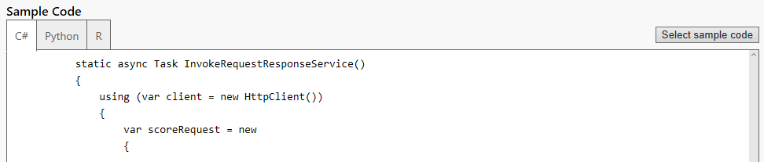
Operationalizing a Machine-Learning Model
A button click in ML Studio deploys a model as a Web service and provides sample code for calling it
Sample code in C#, Python, and R
Notes:
Once deployed as a Web service, a model can be used with simple REST calls over HTTP. This enables developers to build "smart apps" that get their intelligence from ML.

Slide 16
Demo
Operationalizing a Model

Slide 17
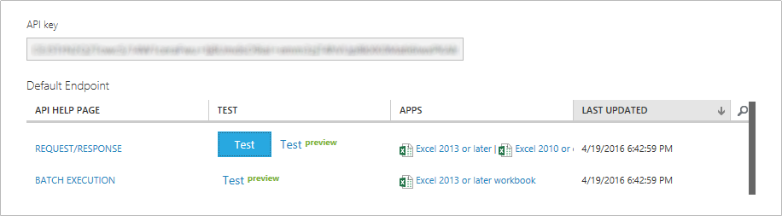
Consuming an Operationalized Model
Get API key from ML Studio
Get Web-service URL from provided code samples
Call Web service over HTTPS
Notes:
You can also use the built-in test harness to input data, or download an Excel spreadsheet that's connected to the model.

Slide 18
Calling a Machine-Learning Web Service
var client = new HttpClient();
client.DefaultRequestHeaders.Authorization =
new AuthenticationHeaderValue("Bearer", "api_key");
client.BaseAddress = new Uri("web_service_url");
HttpResponseMessage response =
await client.PostAsJsonAsync("", request).ConfigureAwait(false);
if (response.IsSuccessStatusCode)
{
string json = await response.Content.ReadAsStringAsync();
.
.
.
}

Slide 19
Demo
Consuming a Machine-Learning Model

Slide 20

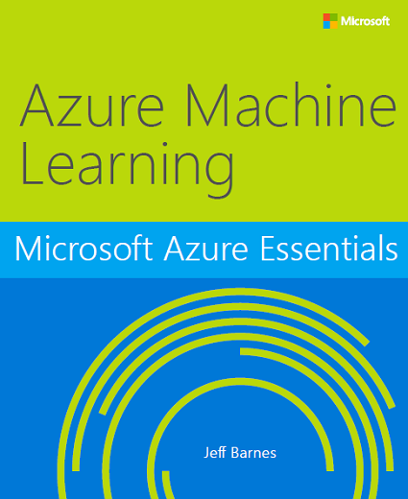
Free e-Book
http://bit.ly/a4r-mlbook

Slide 21
Get the Code
https://github.com/jeffprosise/Machine-Learning

